Slide 1
threads…..!!!!!

Slide 2
Thread vs process:
Process: A process has a self-contained execution environment. A process generally has a complete, private set of basic run-time resources; in particular, each process has its own memory space.
Thread: Threads are sometimes called lightweight processes. Both processes and threads provide an execution environment, but creating a new thread requires fewer resources than creating a new process.

Slide 3
Threads exist within a process — every process has at least one. Threads share the process's resources, including memory and open files. This makes for efficient, but potentially problematic, communication.

Slide 4
Advantages:
Thread minimize context switching time.
Use of threads provides concurrency within a process.
Efficient communication.
Utilization of multiprocessor architectures to a greater scale and efficiency.

Slide 5
Types of Thread:
User Level Threads -- User managed threads
Kernel Level Threads -- Operating System managed threads acting on kernel, an operating system core.

Slide 6
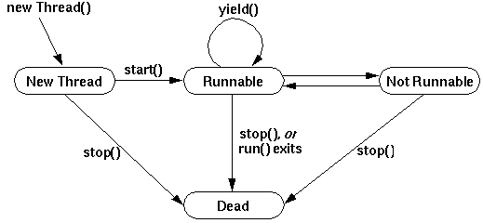
Process state:

Slide 7
Why to use Threads:
If we want our application to perform some parallel activities, we can use threads to meet our needs
Let’s take an example. Assume you are developing a word editor program. In this case, you can have one thread which captures what user the user is typing in and put it into the editor. You can have one more thread running in parallel which may be checking the spelling of the text typed in.

Slide 8
There are two options you have to create threads.
You can write it by extending “Thread” class or by implementing “Runnable” interface
Assume your class already extends one another class. In this case, you do not have any option to extend “Thread” class because java does not allow multiple inheritance. So in this case, your only choice to make a thread is to implement “Runnable” interface. This is possible as your class can extend any other class and at the same time can implement “Runnable” interface. This is one of the main advantage of creating thread by implementing “Runnable” interface over creating thread by extending “Thread ” class.

Slide 9
One difference between implementing Runnable and extending Thread is that by extending Thread, each of your threads has a unique object associated with it, whereas implementing Runnable, many threads can share the same object instance

Slide 10
Creating thread by extending Thread class
1. Let your class extend “Thread ” class
2. Now override the “public void run()” method and write your logic there (This is the method which will be executed when this thread is started)
That’s it, now you can start this thread as given below
3. Create an object of the above class
4. Call the method “start” on the object created. Now our thread will start its execution in parallel.

Slide 11
Implement Runnable Interface...
class ImplementsRunnable implements Runnable {
private int counter = 0;
public void run() {
counter++;
System.out.println("ImplementsRunnable : Counter : " + counter);
}
}

Slide 12
Extend Thread class...
class ExtendsThread extends Thread {
private int counter = 0;
public void run() {
counter++;
System.out.println("ExtendsThread : Counter : " + counter);
}

Slide 13
Use above classes here in main to understand the differences more clearly...
public class ThreadVsRunnable {
public static void main(String args[]) throws Exception {
// Multiple threads share the same object.
ImplementsRunnable rc = new ImplementsRunnable();
Thread t1 = new Thread(rc);
t1.start();
Thread.sleep(1000); // Waiting for 1 second before starting next thread
Thread t2 = new Thread(rc);
t2.start();
Thread.sleep(1000); // Waiting for 1 second before starting next thread
Thread t3 = new Thread(rc);
t3.start();

Slide 14
// Creating new instance for every thread access.
ExtendsThread tc1 = new ExtendsThread();
tc1.start(); Thread.sleep(1000); // Waiting for 1 second before starting next thread
ExtendsThread tc2 = new ExtendsThread();
tc2.start(); Thread.sleep(1000); // Waiting for 1 second before starting next thread
ExtendsThread tc3 = new ExtendsThread();
tc3.start();

Slide 15
output
ImplementsRunnable : Counter : 1
ImplementsRunnable : Counter : 2
ImplementsRunnable : Counter : 3
ExtendsThread : Counter : 1
ExtendsThread : Counter : 1
ExtendsThread : Counter : 1

Slide 16
In the Runnable interface approach, only one instance of a class is being created and it has been shared by different threads. So the value of counter is incremented for each and every thread access.

Slide 17
When to use Runnable?
Use Runnable interface when you want to access the same resource from the group of threads. Avoid using Thread class here, because multiple objects creation consumes more memory and it becomes a big performance overhead.

Slide 18
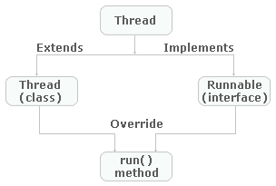

Slide 19
Java doesn't support multiple inheritance, which means you can only extend one class in Java so once you extended Thread class you lost your chance and can not extend or inherit another class in Java.
In Object oriented programming extending a class generally means adding new functionality, modifying or improving behaviors. If we are not making any modification on Thread then use Runnable interface instead

Slide 20
Difference
Inheriting all Thread methods are additional overhead just for representing a Task which can be done easily with Runnable.
Java designer recognizes this and that's why Executors accept Runnable as Task and they have worker thread which executes those task.
is good design decision.
Separating task as Runnable means we can reuse the task and also has liberty to execute it from different means. since you can not restart a Thread once it completes. again Runnable vs Thread for task, Runnable is winner

Slide 21
class NewThread implements Runnable {
String name; // name of thread
Thread t;
NewThread(String threadname) {
name = threadname;
t = new Thread(this, name);
System.out.println("New thread: " + t);
t.start(); // Start the thread
// Create multiple threads.
}

Slide 22
// This is the entry point for thread.
public void run() {
try {
for(int i = 5; i > 0; i--) {
System.out.println(name + ": " + i);
Thread.sleep(1000);
}
} catch (InterruptedException e) {
System.out.println(name + "Interrupted");
}
System.out.println(name + " exiting.");
}
}

Slide 23
class MultiThreadDemo {
public static void main(String args[]) {
new NewThread("One"); // start threads
new NewThread("Two");
new NewThread("Three");
try {
// wait for other threads to end
Thread.sleep(10000);
} catch (InterruptedException e) {
System.out.println("Main thread Interrupted");
}
System.out.println("Main thread exiting.");
}
}

Slide 24
The output from this program is shown here:
New thread: Thread[One,5,main]
New thread: Thread[Two,5,main]
New thread: Thread[Three,5,main]
One: 5
Two: 5
Three: 5
One: 4
Two: 4
Three: 4
One: 3

Slide 25
Three: 3
Two: 3
One: 2
Three: 2
Two: 2
One: 1
Three: 1
Two: 1
One exiting.
Two exiting.
Three exiting.
Main thread exiting.

Slide 26
THREAD PROBLEMS
Threads have their own call stack, but can also access shared data. Therefore you have two basic problems
visibility
access problems.

Slide 27
A visibility problem occurs if thread A reads shared data which is later changed by thread B and thread A is unaware of this change.
An access problem can occur if several thread access and change the same shared data at the same time.

Slide 28
DEAMON THREAD
Daemon thread in java is a service provider thread that provides services to the user thread. Its life depend on the mercy of user threads i.e. when all the user threads dies, JVM terminates this thread automatically.
There are many java daemon threads running automatically

Slide 29
METHODS BY THREAD CLASS
The java.lang.Thread class provides two methods for java daemon thread.
1) public void setDaemon(boolean status) is used to mark the current thread as daemon thread or user thread.
2) public boolean isDaemon() is used to check that current is daemon.

Slide 30
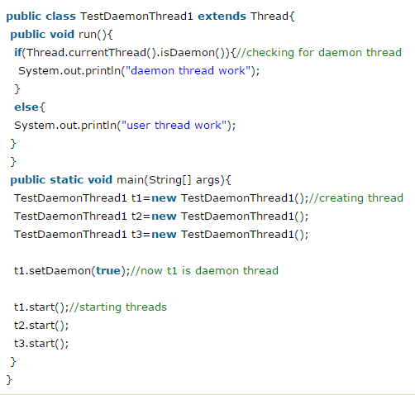
EXAMPLE

Slide 31
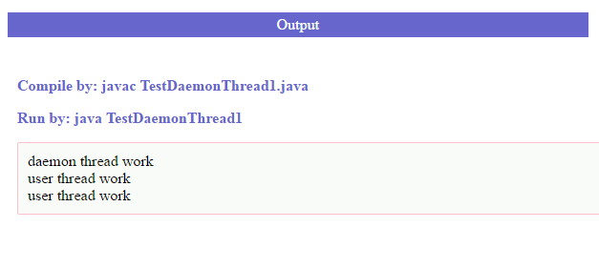

Slide 32
Why we use synchronization
When we start two or more threads within a program, there may be a situation when multiple threads try to access the same resource and finally they can produce unforeseen result due to concurrency issue
So there is a need to synchronize the action of multiple threads and make sure that only one thread can access the resource at a given point in time

Slide 33
Monitors
This is implemented using a concept called monitors. Each object in Java is associated with a monitor, which a thread can lock or unlock. Only one thread at a time may hold a lock on a monitor.
Following is the general form of the synchronized statement:
synchronized(objectidentifier) { // Access shared variables and other shared resources }

Slide 34
Program
class Callme {
void call(String msg) {
System.out.print("[" + msg);
try {
Thread.sleep(1000);
} catch(InterruptedException e) {
System.out.println("Interrupted");
}
System.out.println("]");
}
}
class Caller implements Runnable {
String msg;
Callme target;
Thread t;

Slide 35
Program
class Callme {
void call(String msg) {
System.out.print("[" + msg);
try {
Thread.sleep(1000);
} catch(InterruptedException e) {
System.out.println("Interrupted");
}
System.out.println("]");
}
}
class Caller implements Runnable {
String msg;
Callme target;
Thread t;

Slide 36
Program
class Callme {
void call(String msg) {
System.out.print("[" + msg);
try {
Thread.sleep(1000);
} catch(InterruptedException e) {
System.out.println("Interrupted");
}
System.out.println("]");
}
}
class Caller implements Runnable {
String msg;
Callme target;
Thread t;

Slide 37
Program
class Callme {
void call(String msg) {
System.out.print("[" + msg);
try {
Thread.sleep(1000);
} catch(InterruptedException e) {
System.out.println("Interrupted");
}
System.out.println("]");
}
}
class Caller implements Runnable {
String msg;
Callme target;
Thread t;

Slide 38
Program
class Callme {
void call(String msg) {
System.out.print("[" + msg);
try {
Thread.sleep(1000);
} catch(InterruptedException e) {
System.out.println("Interrupted");
}
System.out.println("]");
}
}
class Caller implements Runnable {
String msg;
Callme target;
Thread t;

